Slide 1

Deep learning
by Tensorflow
재활용 쓰레기 분류 알고리즘에 관한 모델링
Team leader : Kim eun-min
Kang seung-woong, Kim dong-hyeon, Choi seo-yoon

Slide 2
TensorFlow
& Keras
INDEX
Bigdata Analysis
Problem definition
Classification (recycling)
Image feature extraction
Deep learning model
Data collection
재활용 쓰레기 분류 알고리즘에 관한 모델링
Selenium crawling
Data pretreatment
(수작업 처리, 훈련과 테스트 데이터 분류)
Modeling(CNN)
라벨링, 배열화, 정규화
모델링(Sequential, layers)
*Team asterisk

Slide 3

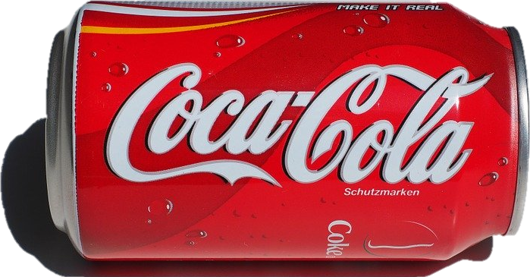

Problem definition
Recycle
*Team asterisk

Slide 4









Plastic
Glass
Can
Styrofoam
Classification

Slide 5
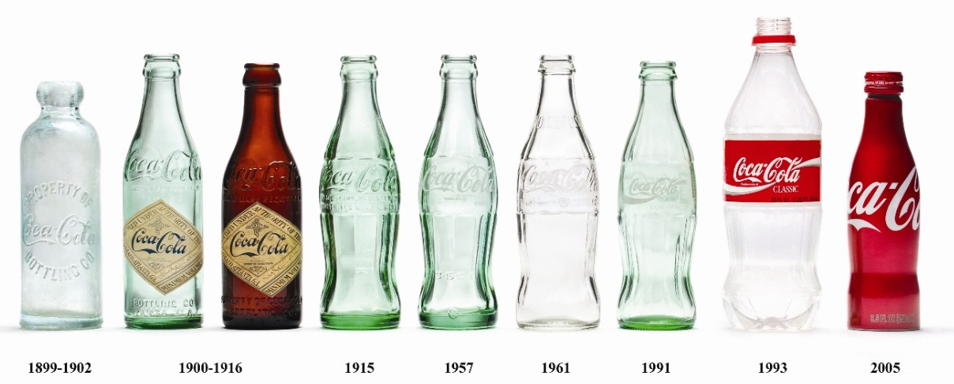
Various Shapes Problem
Feature extraction
*Team asterisk

Slide 6

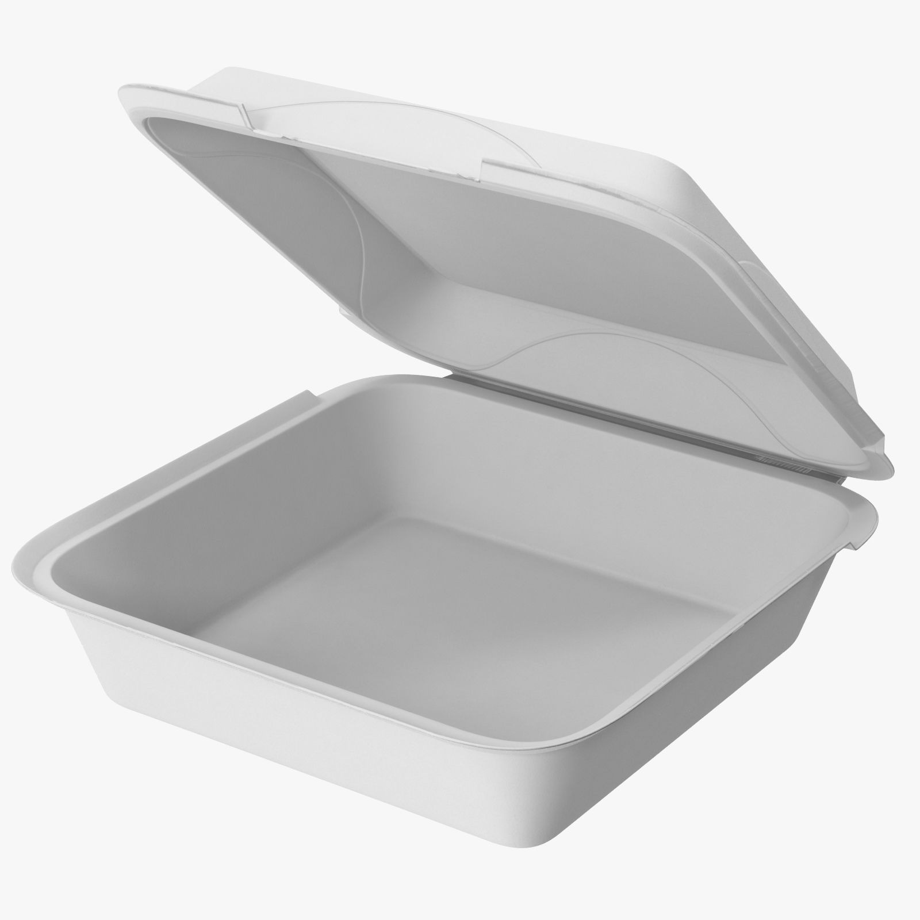
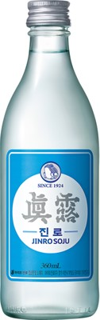

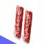

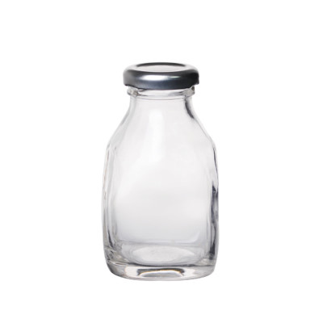
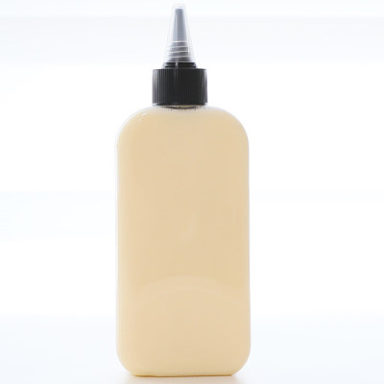
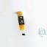
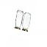
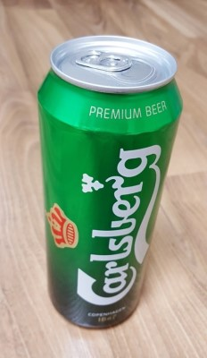
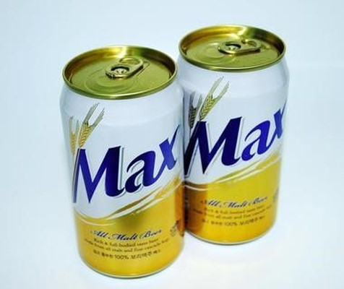
ImageDataGenerator
& reshape
Selenium Crawling
64 X 64
64 X 64
64 X 64
64 X 64
*Team asterisk

Slide 7
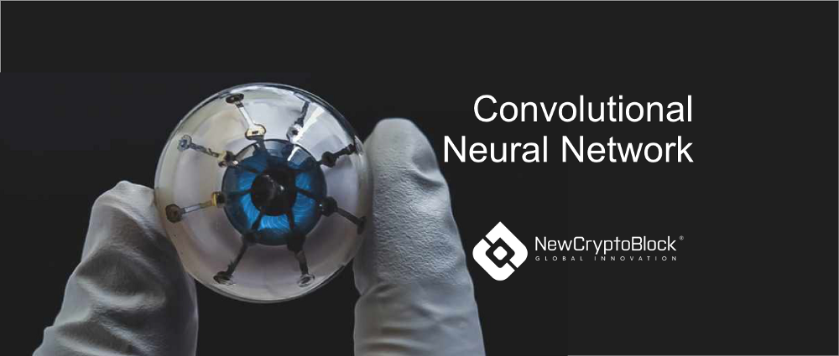
CNN Model
*Team asterisk

Slide 8
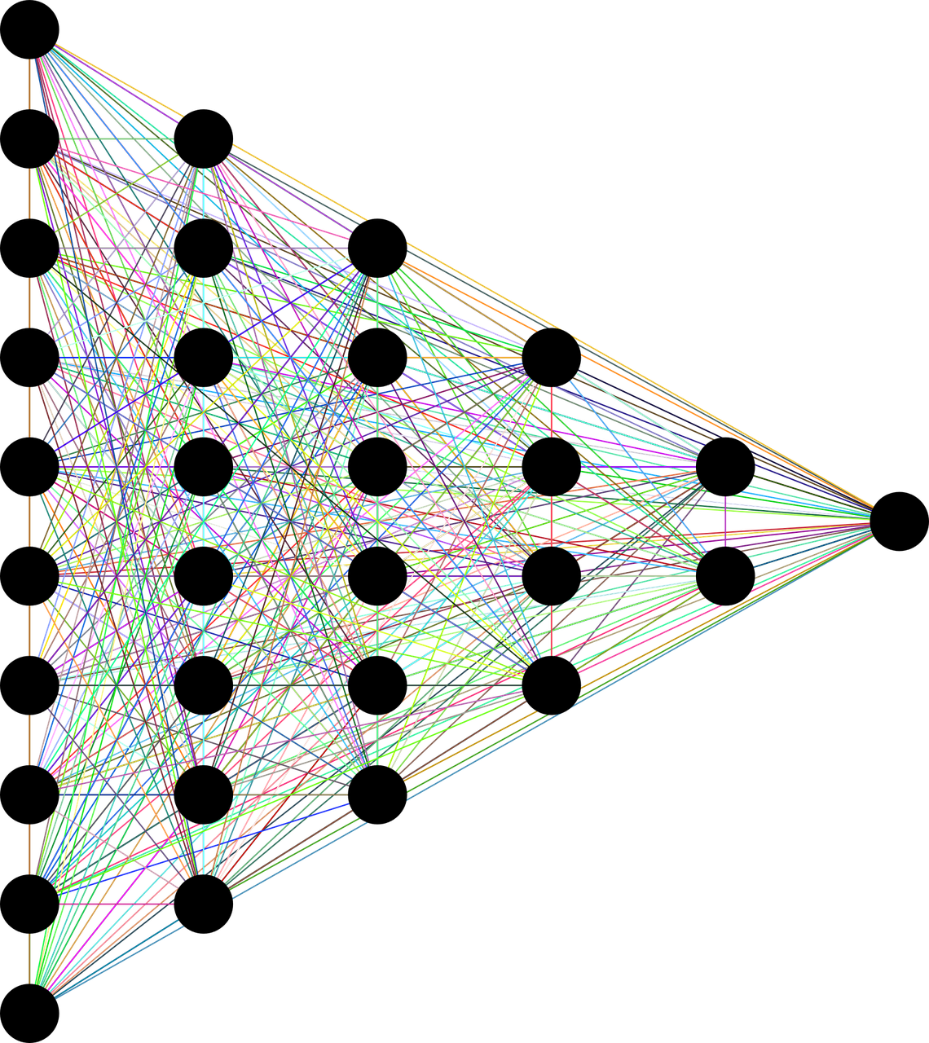
Convolutional Neural Network
Various Shapes Problem
Feature extraction
*Team asterisk

Slide 9
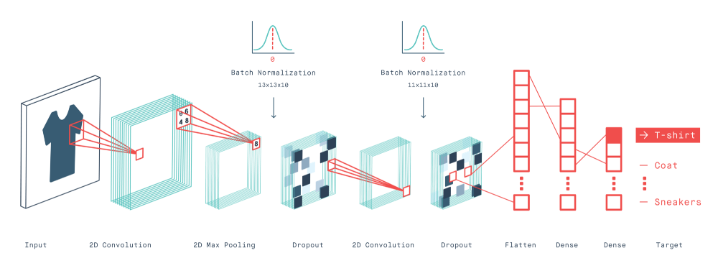
Convolutional Neural Network
-> plastic
can
glass
Sequential
layer
layer
*Team asterisk

Slide 10
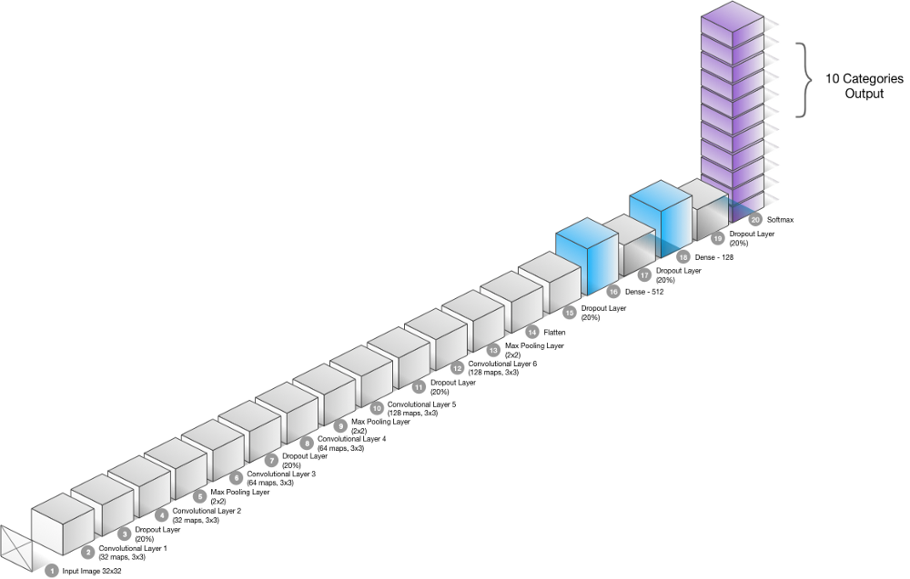
Convolutional Neural Network
*Team asterisk

Slide 11
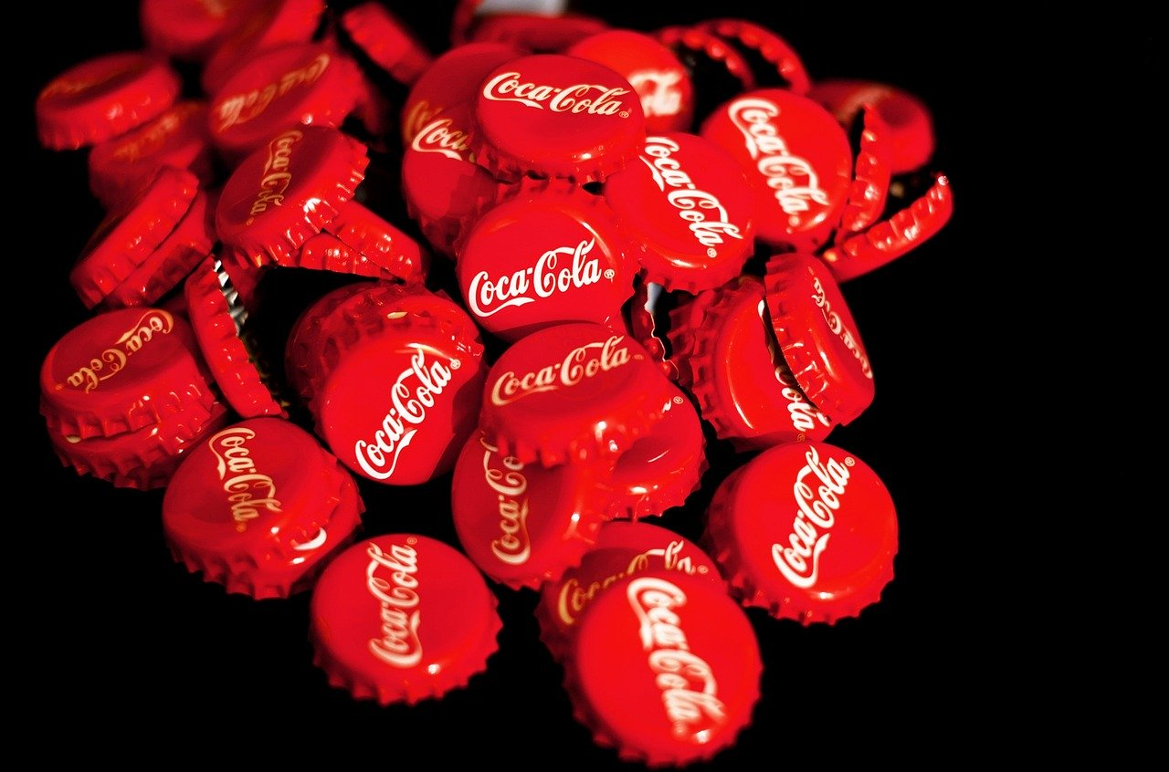
2d max pooling
dense
flatten
2d convolution
CNN Model
dropout

Slide 12
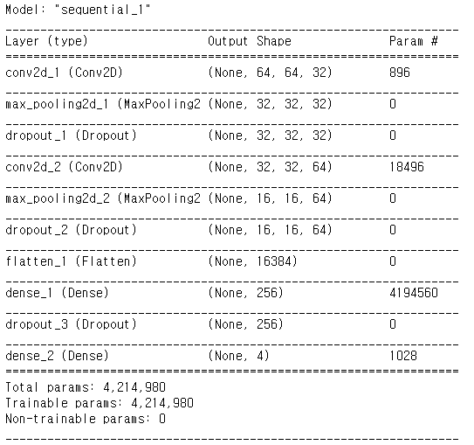
Convolutional Neural Network
*Team asterisk

Slide 13
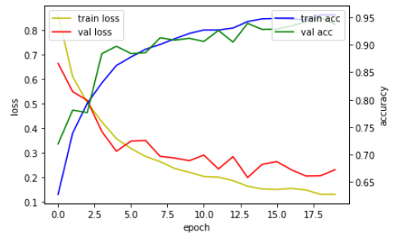
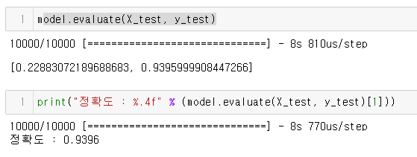
Convolutional Neural Network
*Team asterisk

Slide 14
The end
*Team asterisk

